Slide 1
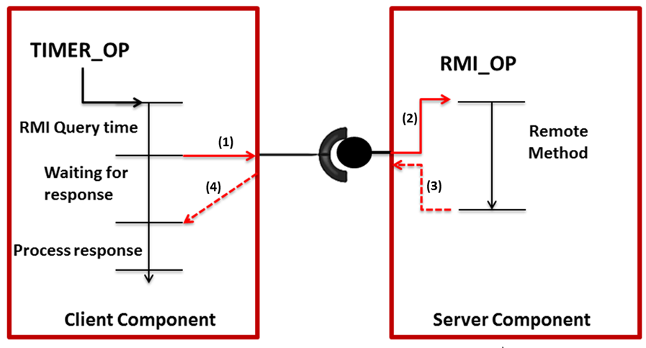
4 ms
12 ms
4 ms

Slide 2

TIMER_OP
RMI_OP
(2)
RMI
Query time
4 ms
Remote
Method
(1)
12 ms
Waiting for Response
(4)
(3)
Process Response
4 ms
CLIENT COMPONENT
SERVER COMPONENT

